Slide 1
Robot Finding Module For Maze using Search Algorithms
The Main Idea Of This Module, Pyamaze,
Is To Assist In Creating Customizable Random Mazes
And Be Able To Work On That,
Like Applying The Search Algorithm especially A* Algorithm
With Much Ease.

Slide 2
A* Search Algorithm
A* Algorithm is one of the best and popular techniques used for
path finding and graph traversals.
A lot of games and web based maps use this algorithm for finding
the shortest path efficiently.
It combines features of Uniform Cost Search and greedy best first search
by which it solve the problem efficiently.

Slide 3
The agent will test whether the freight rate is greater than 30% or not
If it is bigger than 30%, the agent will go to pick up the target and determines the best path to capture the target by using the Depth First algorithm
- If the freight rate is less than 30%, the agent chooses the best way to the place of shipment first and does not go to the target place except when the freight rate reaches 30% at least

Slide 4
Install the Package:
pip install pyamaze
On command prompt run the following command:-

Slide 5
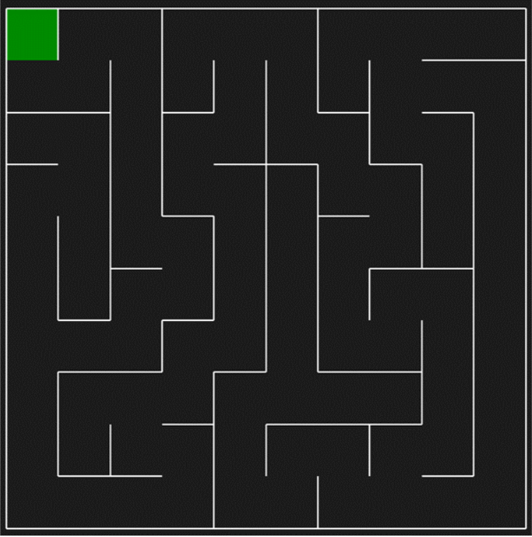
Generate a Maze:
To simply generate a maze, you need to create the maze object and then apply the Create Maze function.
The last statement will be applying the function run to run the simulation.

Slide 6
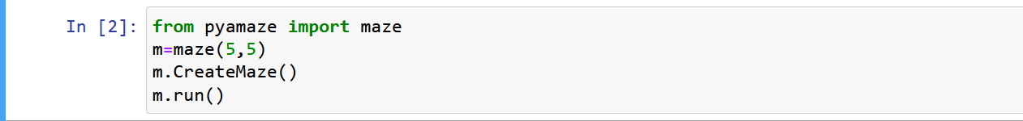
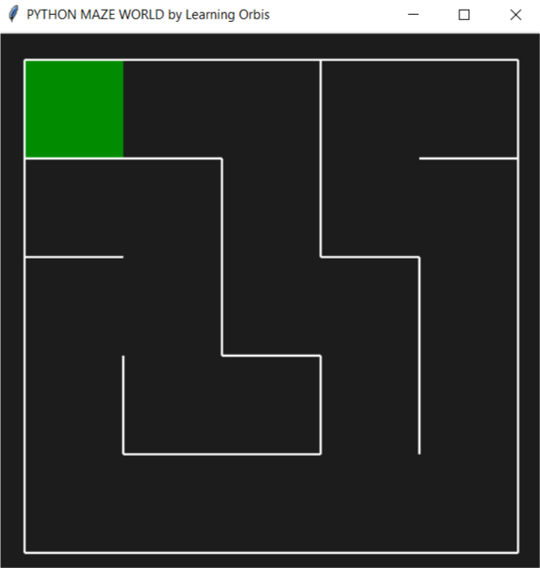
A random 10x10 maze will be generated like this:
We can change the size of the maze while creating that. For example, a 5x5 maze can be generated as:

Slide 7
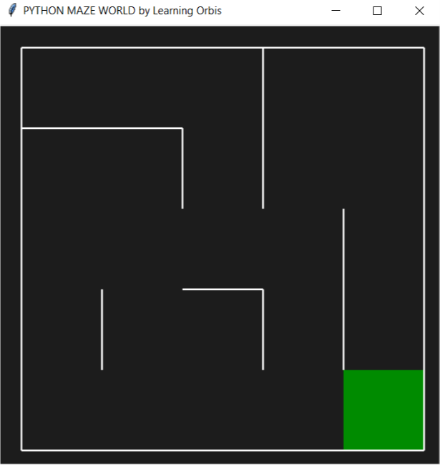
Optional Arguments of Create Maze:
Goal (x and y): To change the goal cell from (1,1) to some other cell we can provide the optional arguments x and y as the goal.
Pattern: We can generate a Horizontal (or Vertical) pattern maze.

Slide 8
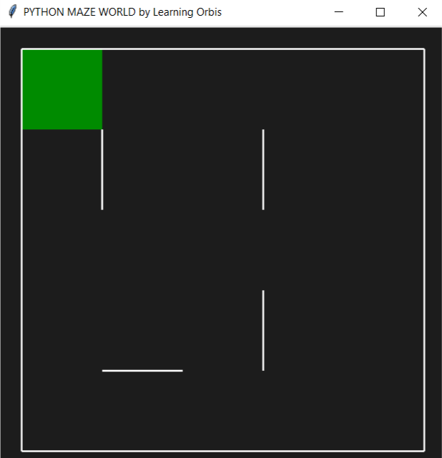
Multiple Paths Maze:
By default, the generated maze is Perfect Maze meaning just the one path from any cell to the goal cell. However, we can generate a maze with multiple paths by setting the optional argument loop Percent to some positive number. Loop Percent set to highest value 100 means the maze generation algorithm will maximize the number of multiple paths for example as:

Slide 9
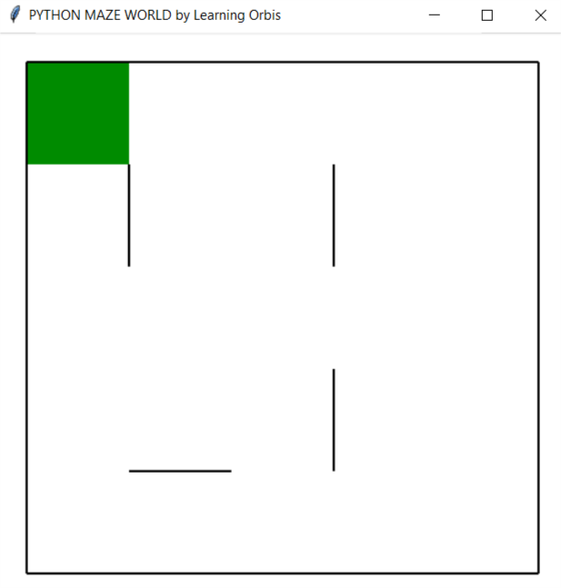
Theme:
The default theme of the Maze is the Dark theme and we can change that to the Light theme by using the argument theme and setting that to the Light theme.

Slide 10
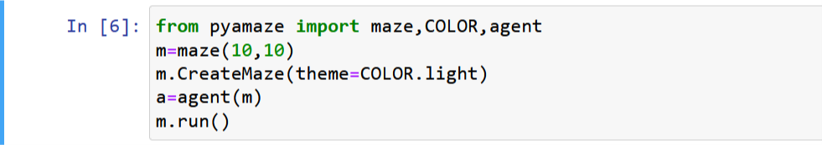
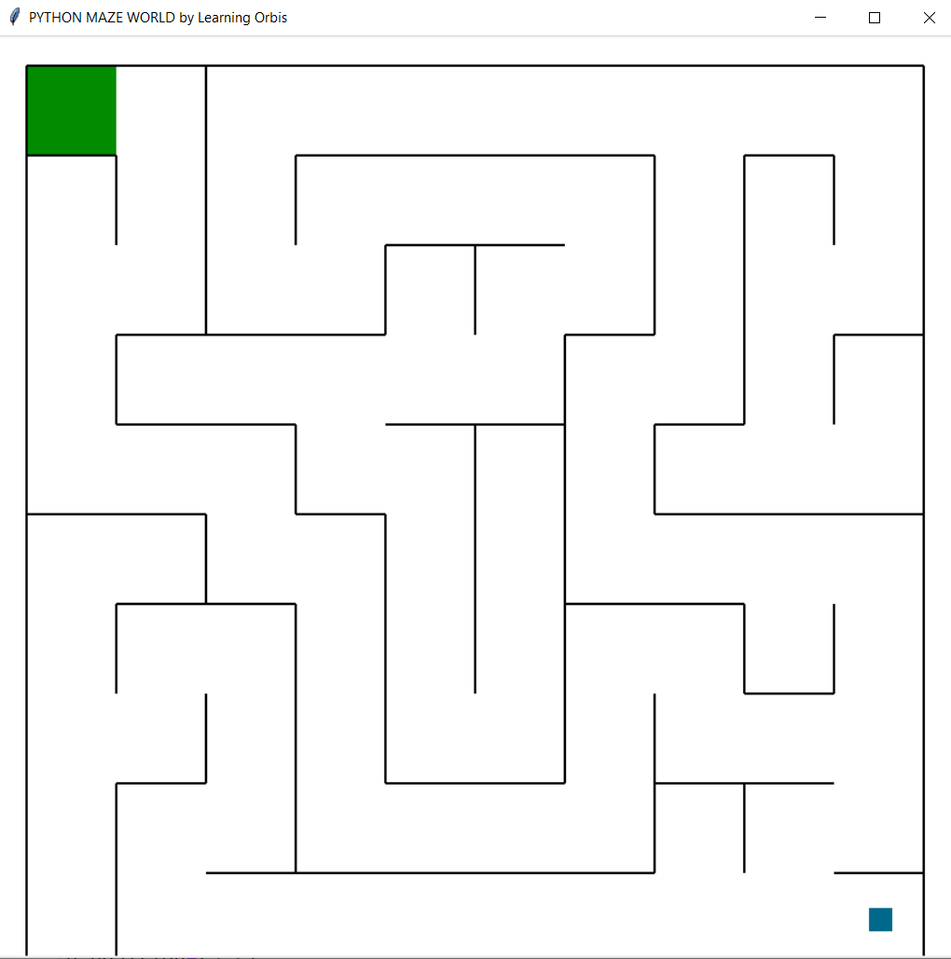
Placing Agents inside the Maze:
We can place agent (one or more) inside the Maze.
An agent can be thought of as a physical agent like a robot or it can simply be used to highlight or point a cell in the maze.

Slide 11
Optional Arguments of the agent class:
Location of the agent: The default location of the agent is the start cell of the Maze which is the bottom-right corner of the Maze.
Goal of the agent: The default goal for the agent is the goal of the Maze meaning the target for the agent is to reach the goal of the Maze.
Size of the Agent: By default, the size of the agent is smaller than the cell dimensions.
Shape of the agent: By default, the agent is of square shape and there is a second option of shape arrow that you can set to the shape argument and the agent will be arrow-head shaped.
See the footprints: When you will implement some search algorithm and the agent will move in the maze, it can be the requirement to visualize the complete path trace.

Slide 12
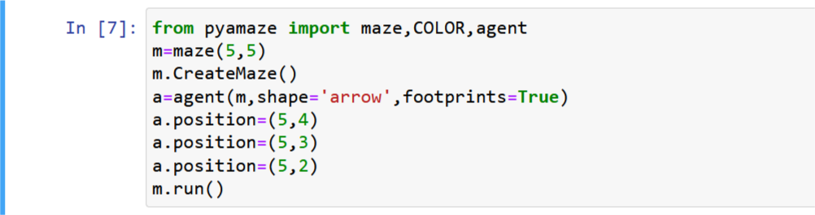
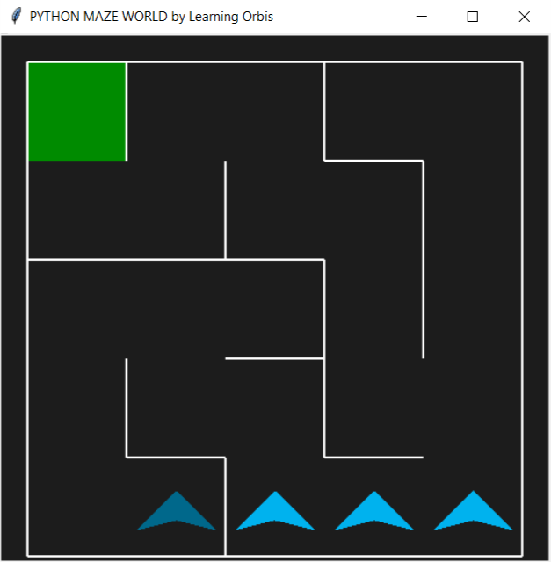
Optional Arguments of the agent class:

Slide 13
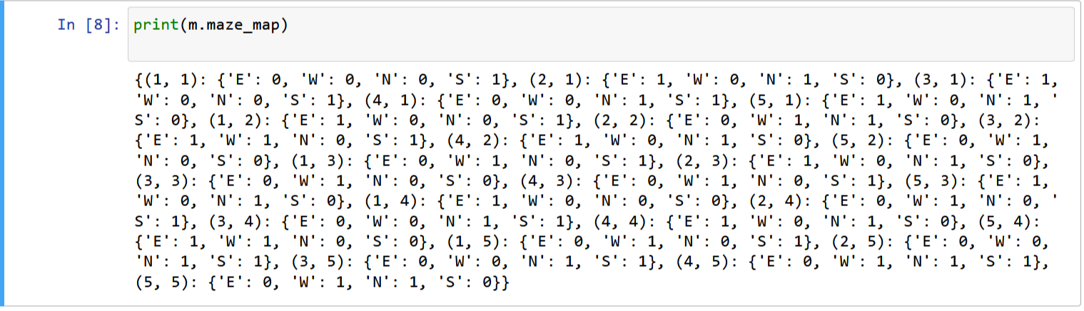
Value of the maze map:
You can see the value of this attribute and confirm the values with the maze generated as:
Path from start to goal: The maze generation algorithm used in the pyamaze module (Recursive Backtracker) not just generates a random maze, but also has the information of the path from start to goal.

Slide 14
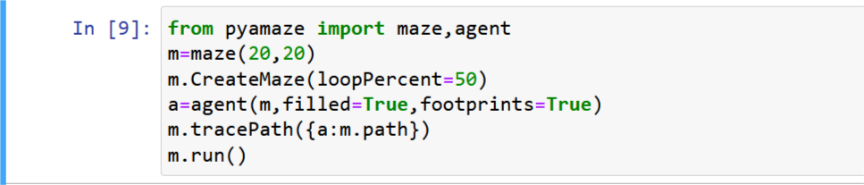
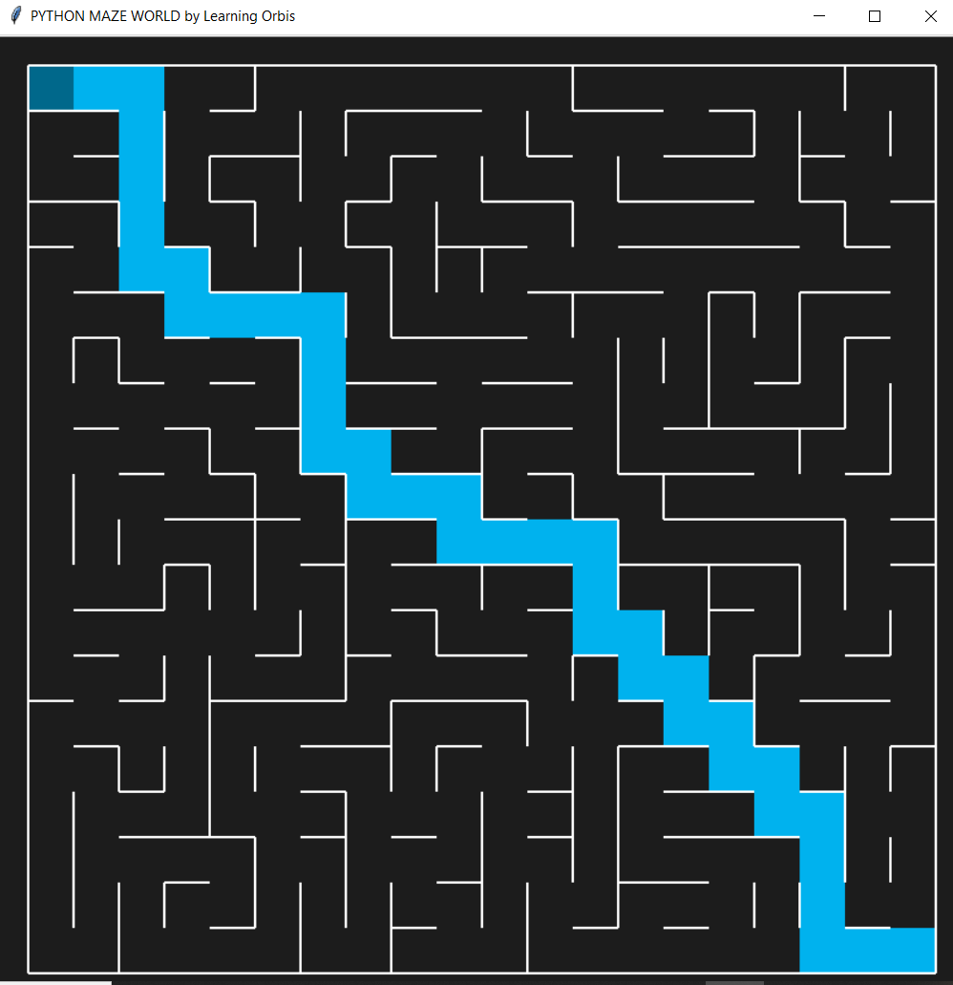
Move the agent on a path: After creating a Maze and agent (one or more) inside the Maze, we can make the agent move on a specific path. The best will be moving the agent on the ***path*** attribute of the maze.
Solution of the maze:

Slide 15
The end

